Slide 1

Minimum Spanning Tree
Kruskal’s Algorithm – Michael Nwabuobi

Slide 2
What is a Minimum Spanning Tree?
A minimum spanning tree is a tree that connects all vertices to a single non - directional tree with the least amount of weighted cost in edges.

Slide 3
Regular tree vs mst

Slide 4
Kruskal’s Algorithm rules
1. Prioritize minimum weighted edges.
2. No cycles

Slide 5
Kruskal’s Algorithm is a greedy algorithm. It sticks with the pre -established rules and makes the best choice for the current iteration in the task and never changes it decision.

Slide 6
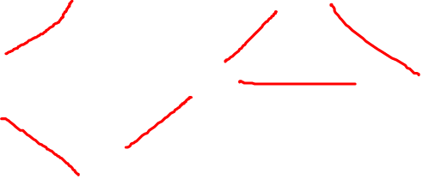
Uses of mst
Cable laying
Computer Networks
Road Mapping
Hydraulic connections

Slide 7
Uses of mst
Travelling Salesman problem
Multi-terminal minimum cut problem
Cost weighted perfect matching
Cluster Analysis
Handwriting recognition
Image Segmentation

